Slide 1

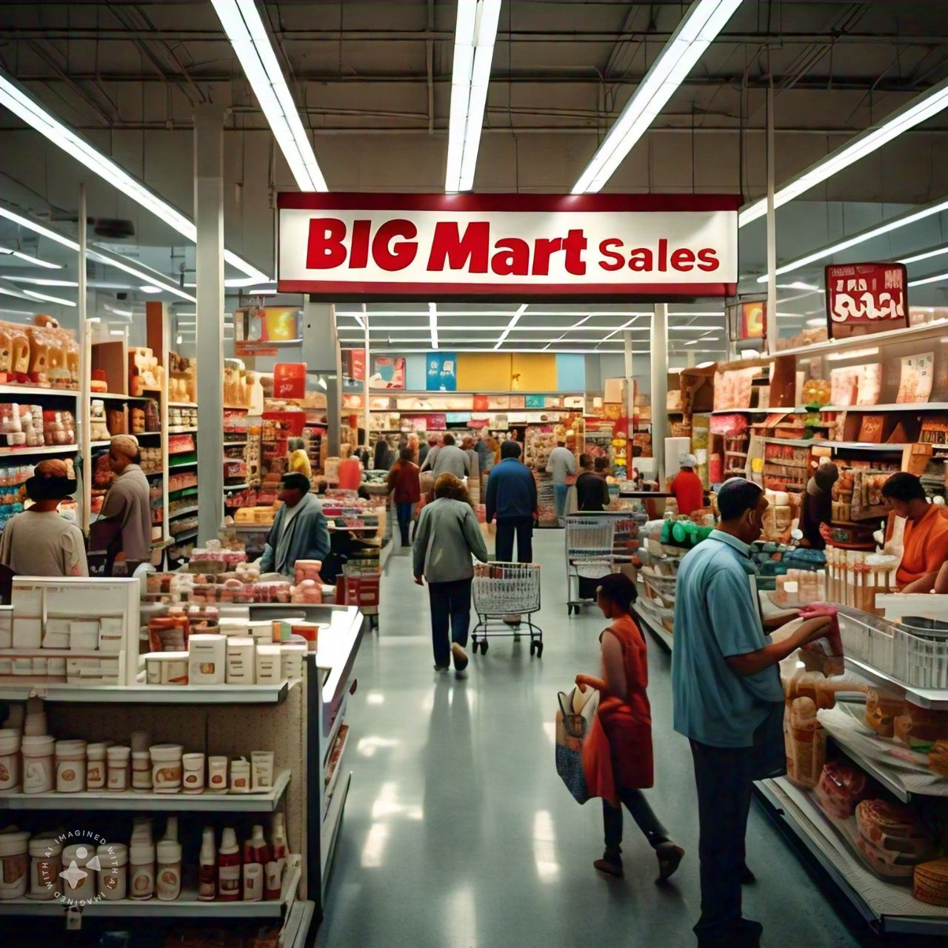
Big Mart Sales Prediction

Slide 2

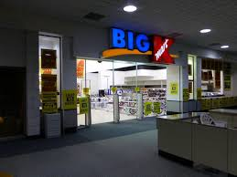
CONTENT
ABSTRACT
Problems & Solutions
Requirements specification
Architecture diagram
Existing system
Proposed work
Machine learning models
XGBRF Regressor
Advantages
Applications
Working & Result
Conclusion

Slide 3
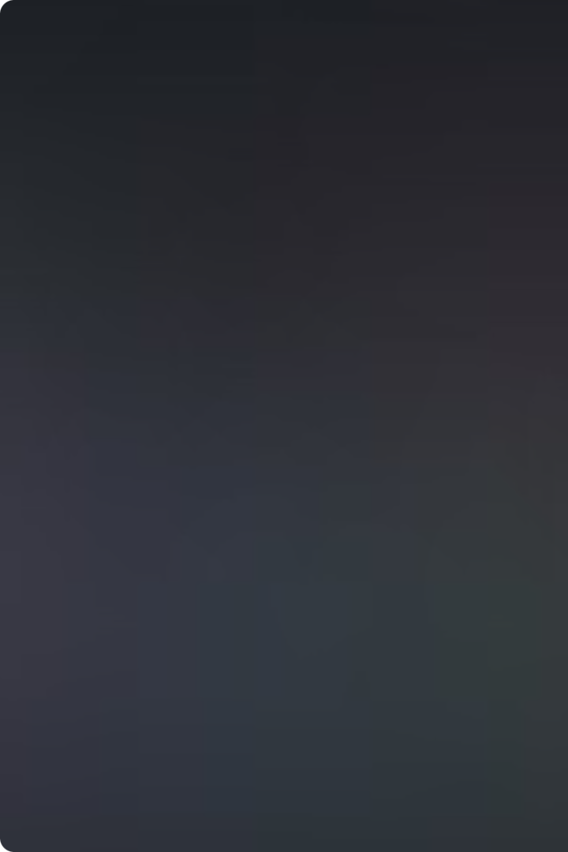
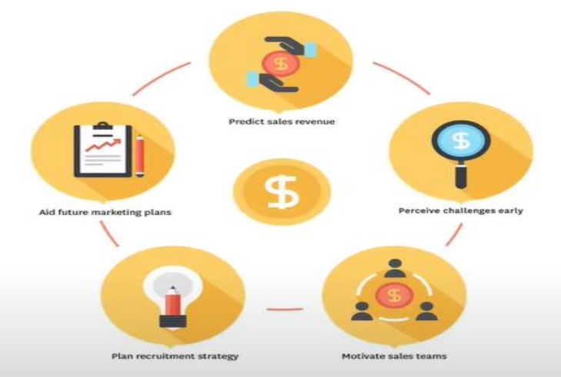
Abstract
Now a days shopping malls and Big Marts keep the track of their sales data of each and every individual item for predicting future demand of the customer and update the inventory management as well. These data stores basically contain a large number of customer data and nndividual item attributes in a data warehouse. Further, anomalies and frequent patterns are detected by mining the data store from the data warehouse. The resultant data can be used for predicting future sales volume with the help of different machine learning techniques for the retaile like Big Mart.

Slide 4
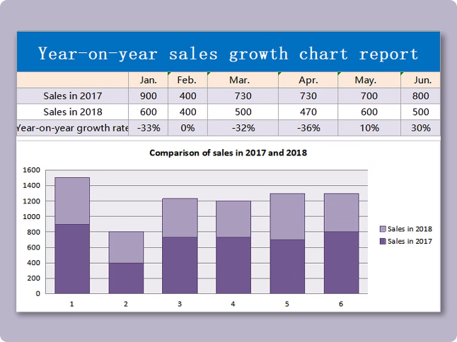
Introduction
Big Mart Overview
Sales Prediction Importance
Big Mart is a leading retail chain with multiple stores across the country, offering a wide range of products to its customers.
Accurate sales forecasting is crucial for Big Mart to optimize inventory, staff scheduling, and strategic decision-making.
Project Goals
Develop a machine learning model that can reliably predict future sales for each store and product category.

Slide 5

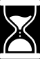
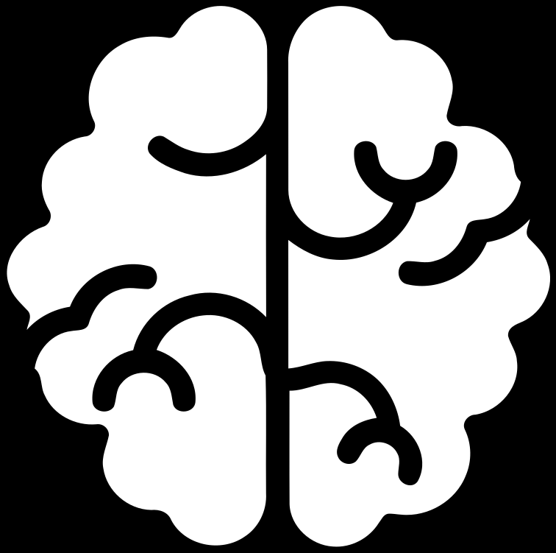
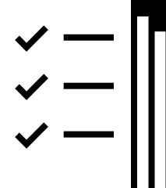
PROBLEMS AND SOLUTIONS
Insufficient Data Quality
Clean and preprocess the data, handle missing values, and address outliers to improve the overall quality of the dataset.
Business Understanding
Collaborate closely with domain experts to ensure that the model aligns with the business objectives and effectively addresses the nuances of sales prediction in the specific context of BigMart.
Model Selection
Experiment with different regression algorithms (e.g., linear regression,random forests) and choose the one that best fits the characteristics of the data.

Slide 6


REQUIREMENTS SPECIFICATION:
Hard disk: 500 GB and above.
Processor: i3 and above.
Ram: 4GB and above.
SOFTWARE REQUIREMENTS :
Operating System: Linux
Software: python
Tools :Anaconda (Jupyter Note Book IDE)

Slide 7
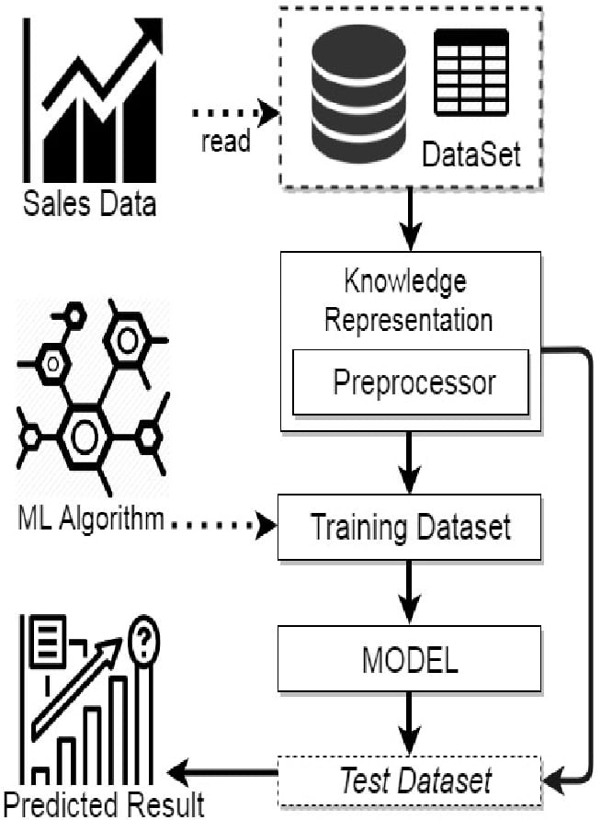

ARCHITECTURE DIAGRAM

Slide 8
EXISTING SYSTEM:
The existing system for Big Mart sales prediction typically involves using data from historical sales records, product attributes, and store information. Various machine learning algorithms, such as regression models may be employed.
The accuracy that these machine learning models providing which is not meeting the expectations of customers sale suitability so that it may lead to failure in the accurate prediction of sales in the Big Mart products.
Existing system models prediction analysis which gives less accuracy.
In order to overcome the problems we introduces a new model.

Slide 9
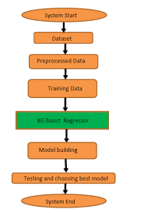
PROPOSED WORK:
The system that we introduced is called XGBRF Regressor machine leraning model which has a best accuracy rate in the Big Mart sales prediction system which results accurate sales that suits for the Big Mart.After comparing and taking an analysis of the different machine learning algorithms we conclude that the XGBRF Regressor is the best one which has a high accuracy rate when compares to the exiting algorithms.

Slide 10

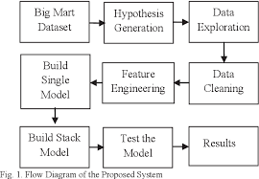
Data Collection and Preprocessing
1
Data Gathering
Collect historical sales data, product information, and store-level attributes from Big Mart's internal systems.
2
Data Cleaning
Handle missing values, remove outliers, and ensure data consistency and quality.
3
Feature Extraction
Extract relevant features from the raw data, such as product categories, store locations, and promotional activities.

Slide 11
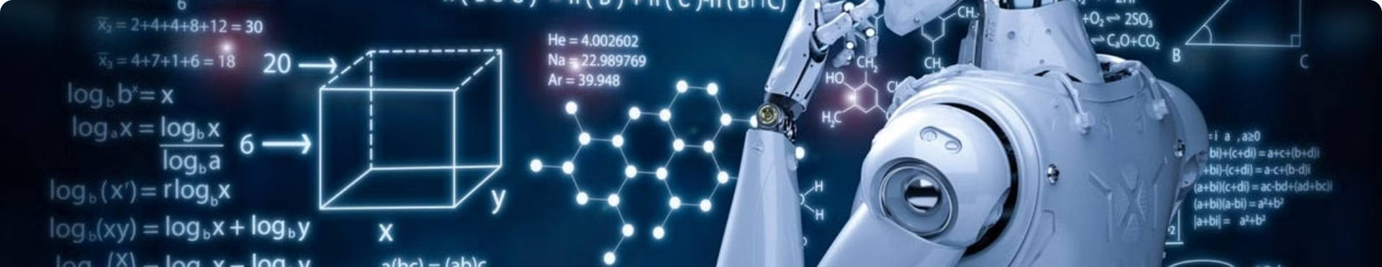

Model Selection and Training
Linear Regression
Random Forest
XGBoost
Assess the performance of a simple linear model as a baseline.
Utilize ensemble methods like Random Forest to improve predictive accuracy.
Apply gradient boosting algorithms, such as XGBoost, to further enhance the model's performance.

Slide 12

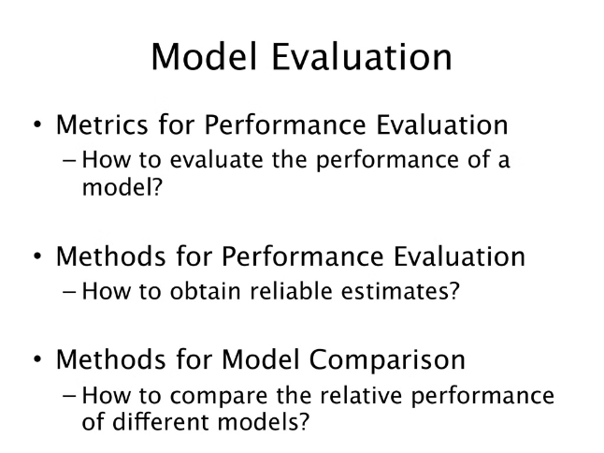
Linear Regression
Linear Regression is a statistical method that models the relationship between a dependent variable and one or more independent variables by fitting a linear equation to observed data. It is widely used for predicting outcomes and understanding the strength of predictors' relationships with the dependent variable.
Linear Model Accuracy – 52%

Slide 13
XGBRF REGRESSOR:
Random Forest:
XGBRF Regressor is an algorithm used for regression tasks, and it's an extension of the popular XGBoost algorithm. XGBRF stands for eXtreme Gradient Boosting with Random Forest. It combines the boosting technique of XGBoost with the randomness of a random forest. The algorithm builds an ensemble of decision trees and optimizes their performance through iterative boosting, enhancing predictive accuracy for regression problems. It introduces randomness in the tree-building process, which can help prevent overfitting and improve generalization to new data.
XGBRF Regressor accuracy - 59.55%
The Random Forest algorithm is a versatile machine learning technique that constructs multiple decision trees during training and merges their outputs to improve predictive accuracy and control overfitting. It is widely used for both classification and regression tasks due to its robustness and ability to handle large datasets with higher dimensionality.
Random Forest Model Accuracy – 55%

Slide 14
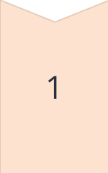
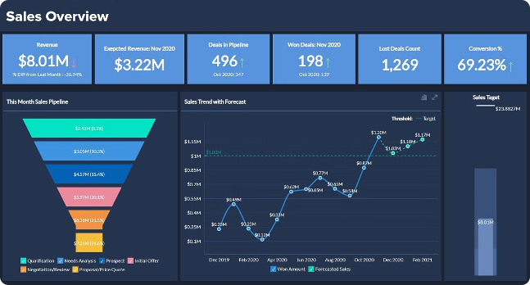
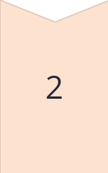
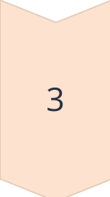
Sales Prediction and Insights
Store-level Insights
The model can identify the most influential factors for sales at each store, such as product mix, promotions, and foot traffic.
Product Performance
Analyze the sales patterns and drivers for individual products to optimize inventory, pricing, and merchandising strategies.
Forecasting Accuracy
The XGBoost model provides highly accurate sales predictions, with an R-squared of 0.91 and low RMSE and MAE.

Slide 15
ADVANTAGES
It can be very useful for solving decision related problems.
Main objective of this work is to establish sales performance goals for the organization and to maintain the inventory products.
Consistent product availability due to effective sales prediction contributes to better customer satisfaction, as customers can rely on finding the products they need.

Slide 16
APPLICATIONS
New Product Launch Planning
E-commerce Recomendation
Financial Investment Decisions
Pharmaceuticals

Slide 17
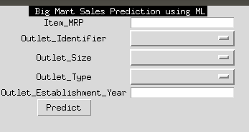
WORKING
Step 1:
Open the Graphical User Interface and where we fill our data

Slide 18
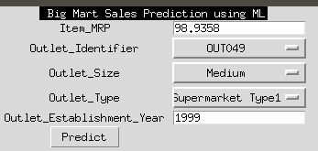
Step 2:
Fill all the data in the given form and press predict button to get the prediction. (All the data will then be send to the nondescript and then to the prediction model for processing.)

Slide 19
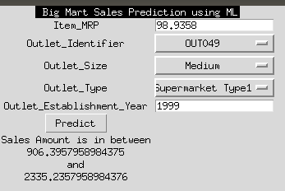
Step 3:
View the predicted result

Slide 20
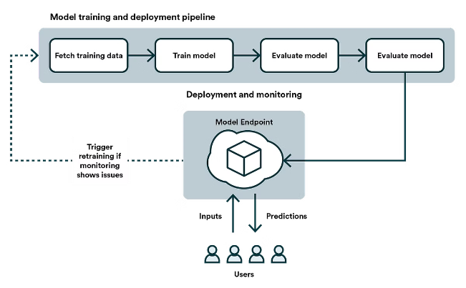
Deployment and Monitoring
1
Model Integration
Seamlessly integrate the sales prediction model into Big Mart's existing business intelligence and decision-making systems.
2
Continuous Monitoring
Continuously monitor the model's performance and update it with new data to maintain high accuracy and relevance.
3
Reporting and Visualization
Develop interactive dashboards and reports to provide store managers and executives with real-time insights and forecasts.

Slide 21
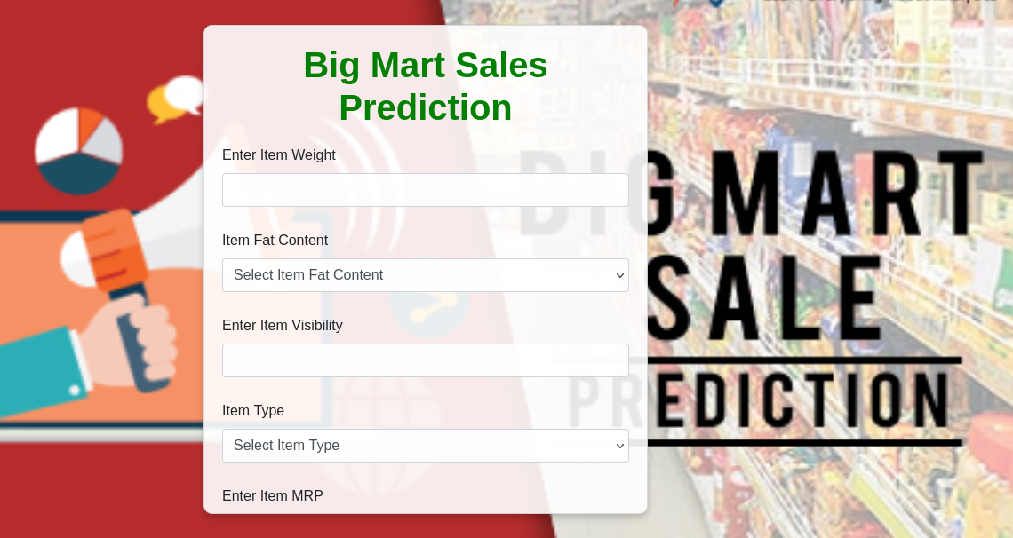
Flask Application Setup:
The sales prediction model was deployed using a Flask web application, which serves as the interface for interacting with the model. The Flask app handles incoming prediction requests and returns sales forecasts in real-time.

Slide 22

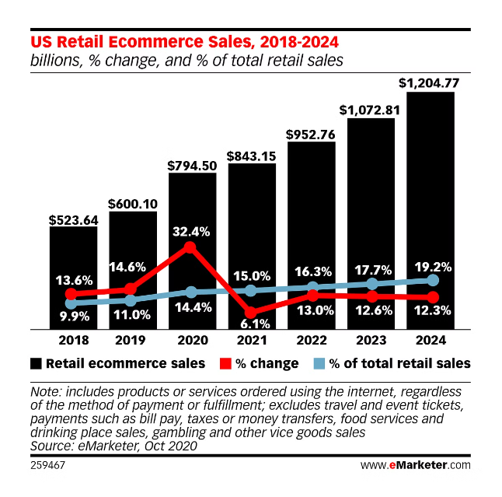
Conclusion
Key Takeaways
Future Opportunities
The sales prediction model developed for Big Mart has demonstrated high accuracy and the ability to generate valuable business insights.
Explore the integration of additional data sources, such as economic indicators and customer behavior, to further enhance the model's performance.
Next Steps
Continuously refine and optimize the model to ensure it remains a valuable tool for driving strategic decisions and improving overall business performance.

Slide 23


